Slide 1
The Printing Process

Slide 2
Final Artwork Preparation

Slide 3
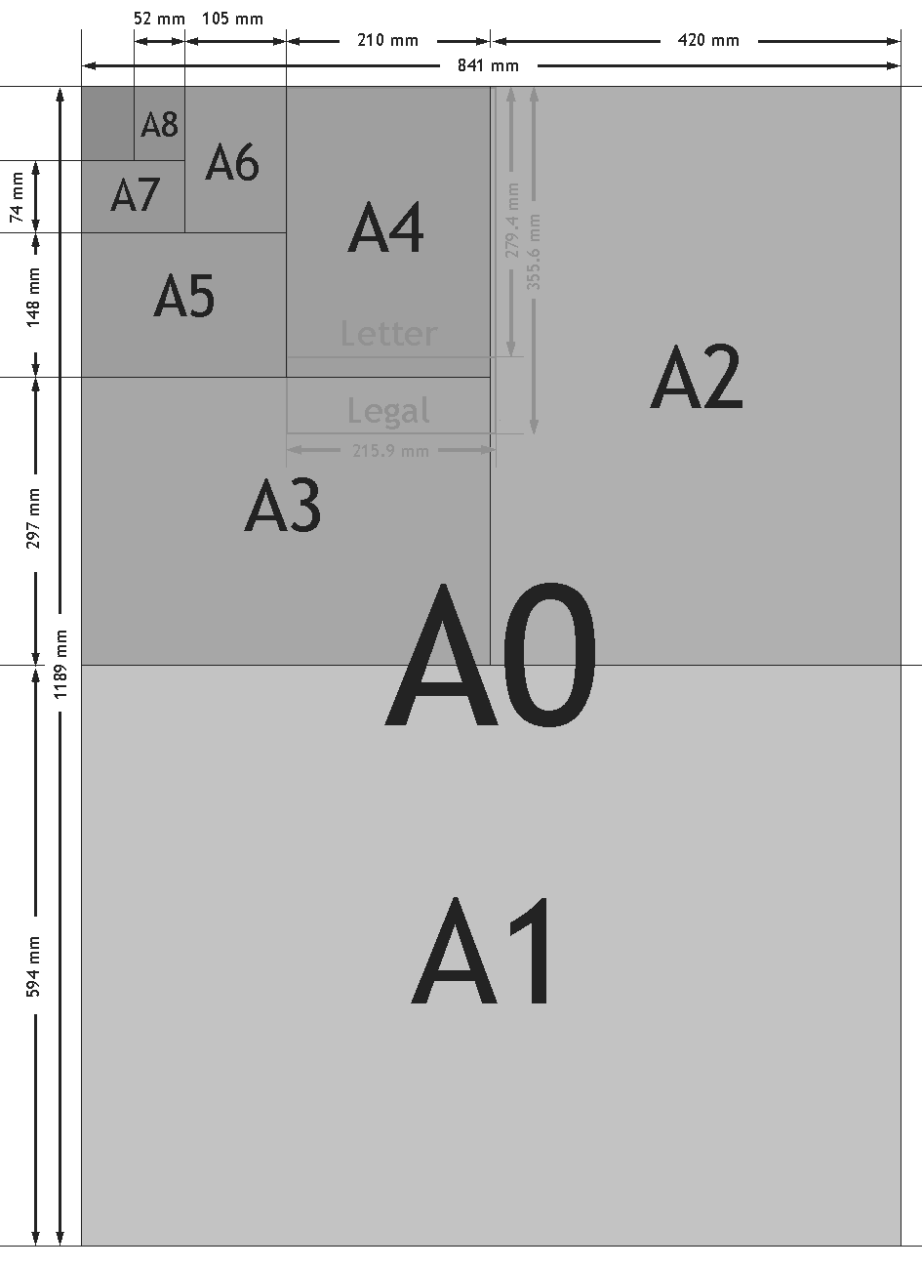
Double check
- Layout size, A4? , A3? postcard

Slide 4
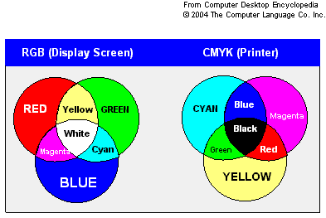
Double check

Slide 5
Double check
CMYK – Process Color
Mixture of CMYK
Pantone – Solid color
Color is consistent
RGB – Vibrant Color
Did not involved black

Slide 6
Crop Mark
Crop/Trim Mark (hairline) horizontal and vertical rules that define where the page should be trimmed.
Go to Effect >> Crop Marks

Slide 7
Bleed
Bleed is the amount of artwork that falls outside of the printing bounding box, or outside the crop area and trim marks. An image that bleeds off the edge of the printed sheet) should be at least 0.5mm.

Slide 8
Create Outlines
Convert text to outlines for press-ready vector artwork is essential knowledge. Fonts can cause problems when sending artwork to press.
Make sure some of the text in the page is not locked individually. If will alert you with missing font files.
To convert text to outlines, Go Select >> Select All.
Go Type >> Create Outlines.

Slide 9
Fonts
Some software does not have create outlines like
Microsoft Publisher. Prepare the fonts in the folder
to pass to the printer
Go to C:Window >> fonts folder

Slide 10
Pre-Printing Process
Colour Proofs
Cost/Price
Types of paper
Quantity

Slide 11
Colour Proofs
Colour proofs helps us and the printer to print items accurately

Slide 12
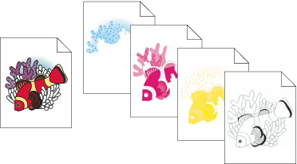

Slide 13
You can also include custom inks
(called spot colors).
In this case, a separate plate is created for each spot color. When inked with the appropriate color and printed in register with one another, these colors combine to reproduce the original artwork.

Slide 14
Cost/Price
Make a mock-up so that the printer can do a costing for you.
You must know how many colour print, size, one fold, two fold and quantity in mind

Slide 15
Cost/Price
You must know …
Quantity: 500 pcs, 1,000 pcs, 3,000 pcs
or 10,000
Colour print: Outside and inside
Size: A5, A4, Letter paper or in numbers
Type: One fold, two fold and no fold

Slide 16
Types of paper
Types of paper in mind. There are many types.
Name of paper like Simili paper, Glossy paper, Matt paper,
Name/Post card: Simili card, Artcard, 513 card

Slide 17
Types of paper
Weight of the paper
80gsm, 100gsm, 105gsm, 150gsm, 128gsm, 157 gsm,
Weight of the card
200gsm, 230gsm …

Slide 18
Communication
Make friend with the printers.
Have an understanding of how printers do their works.
Not all of them do things the same ways.
Examples… bigger printer company…smaller company

Slide 19
Communication
Information:-
- PrintMate, Puchong (offsets) Gary – 0193181076
- Watson, D’sara Jaya (offsets, digital) Mr Ng - 012 308 3755
- Enigo.com.my (Puchong)
- www.xprint.co (DUMC Chinese Church)

Slide 20
Communication
- LC Graphic, Joey – Kota D’sara Tel: 03-6141 8218 (Digital print)
- Inkjet D’Next, Charry Ng – Puchong
Tel: 012 359 8880 (Digital print)

Slide 21
Communication
- Jstar printing, Joseph-Puchong
012 390 9950 (Digital print)
- Vertex Print, Chan – Puchong
012 395 9730

Slide 22
The End

Slide 23
Thank You!

Slide 24
Social Media
After sending for printing, we can also
prepare for
- Facebook
- Blog
Website
Email

Slide 25
Project
Break into 2 group
TEAM 1: Jamie & Andy
TEAM 2: I Wei, Sabrina & Eugene
TOPIC : ELECTION CAMPAIGN

Slide 26
Project
RESEARCH
BRAINSTORM
EXECUTE
PRINT & PRESENT

